Slide 1

Ansible in Operation

Slide 2
Learning Goals
Manage inventory
Ansible ad-hoc commands
Write & run Playbooks
Understanding of variables
Explain variable inclusion
Activate and manage task control

Slide 3
Inventories
A list of hosts, groups and aspects of hosts
Can be dynamic or static
Groups defined by brackets [] and by name
  Describe systems
  Decide what systems you are controlling at what times and for what purpose (roles)
  Groups can be nested with :children
Hosts can be in more than one group
  server could be both a webserver and a dbserver.
  variables will come from all of the groups they are a member of

Slide 4
Static Inventories
Static inventory : simplest, most common form
Add a group
Add host variables
localhost
localhost
[CentOS]
localhost
Localhost ansible_ssh_host=127.0.0.1
[CentOS]
localhost

Slide 5
Dynamic Inventories
Static inventories negate the environment of the cloud
Can use almost data source to generate dynamic inventories

Slide 6
Checkpoint: Run an empty play
git init
Configure an inventory file
Create at least one group (by OS)
Start a playbook
Run the empty playbook against all hosts

Slide 7
Ansible: Configuration Management
Lengthy, fine-grained system configuration,
  e.g. adding users, ssh keys, installing and configuring services, and bootstrapping systems to a given state.
"Configuration remediation" – ensure consistent server configuration.
  removes manual configuration errors
  Checks for ”Configuration Drift”
Version-controlled – service configurations can be reliably reproduced.

Slide 8
Ansible: Deployment and Orchestration
Separate physical infrastructure from tasks
Allow model-based description of services
Good for complex, interdependent service deployment

Slide 9
Aspects of Ansible
Simple connection model :
  No master-slave relationships
  Everything can configure everything (even self-configuration)
  No custom agent to set up
  Security provided by SSH
  Simplest mode is push from control node to controlled nodes

Slide 10
Vocabulary
Inventory:
  Hosts
  Groups
Execution:
  Tasks
  Plays
  Playbooks
Batteries:
  Modules
  Library

Slide 11
Vocabulary: Inventory
Hosts
  A remote machine that Ansible manages
  Can have individual variables (host name, connection port number, etc)
Groups
  Easy way to combine hosts with similar aspects
  All hosts in a group share group variables
Inventory
  Fill description of hosts which you own and control
  Can nest groups and move hosts in and out of groups

Slide 12
Vocabulary: Execution
Playbook
  How Ansible orchestrates, configures, administers or deployes systems
  A combined, coherent description of a complex state of applications, hosts, services.
Plays
  A mapping between a set of hosts and the tasks which run on those hosts
  defines the role that those systems will perform.
  There can be one or many plays in a playbook
Tasks: Application of a single module on the specified host(s)

Slide 13
Vocabulary: Batteries
Modules:
  units of work that Ansible ships out to remote machines.
  can be implemented in any language.
  Return JSON or simple key=value pairs.
  Once modules are executed on remote machines, they are removed, → no long running daemons used
Library:
  Collection of available modules

Slide 14
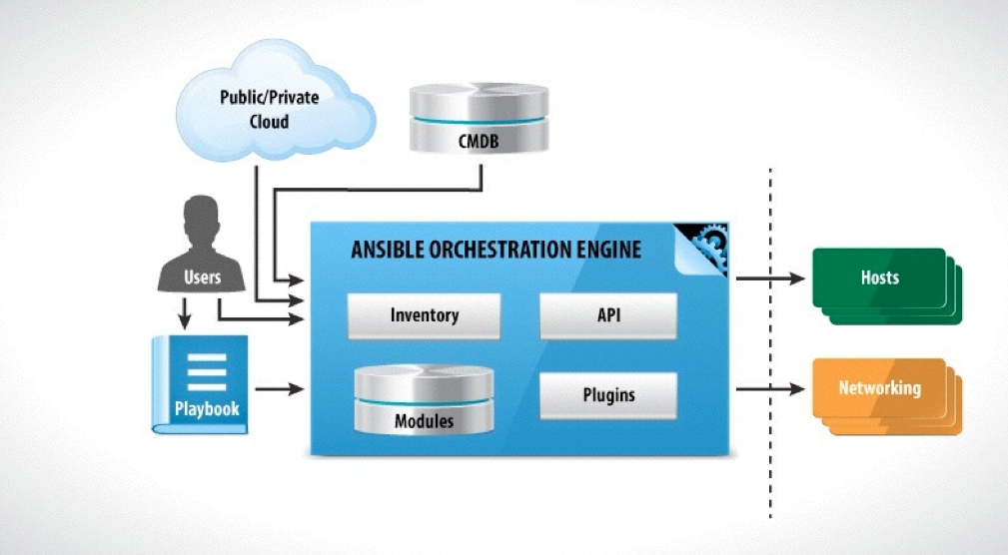
Architecture
http://slides.com/racku/ansible-fundamentals#/4/17

Slide 15
Not Covered Yet
Variables
Filters
Conditionals
Loops

Slide 16
Ansible: Footprint
Control machine:
  *NIX (no Windows yet)
  (Optional) SSH Client
  Python 2.6
  Since 2.0 dependencies are maintained with pip
Managed node:
  OpenSSH server
  > Python-2.4

Slide 17

Hands-on session
Install Ansible

